Slide 1



Predicting student dropout in higher education
Developers Institute
Data Analytics
Course DA 157
Florencia Ogorinsky

Slide 2



IMPACT OF HAVING FEWER GRADUATES
Lost time and money: Many students invest years and financial resources without obtaining a degree
Frustration and demotivation: Dropping out can negatively impact mental health
Lower rankings and reputation: Retention and graduation rates are key quality metrics for academic institutions
Financial loss: Fewer graduates may mean less revenue from alumni donations, postgraduate programs, or continued enrollment
Less qualified workforce: Fewer graduates lead to talent shortages in critical areas like healthcare, education, and tech
Increased social inequality: Higher education is a key driver of social mobility. A high dropout rate widens the gap between socioeconomic classes
Wasted public investment: If governments fund education but students don’t graduate, it results in inefficient use of public resources

Slide 3


DATASOURCE
The dataset contains 4,424 student records and 35 columns, covering:
Demographics: age, gender, marital status, nationality
Academic background: previous qualification, admission mode/order Socioeconomic indicators: parents’ education and occupation, whether the student is a debtor, scholarship holder, etc.
Academic performance: grades, approved/evaluated/enrolled subjects in both semesters
Macroeconomic variables: unemployment rate, inflation, GDP Target: Student status – Dropout, Enrolled, or Graduate
KAGGLE DATASET
COLUMN DESCRIPTION AND ENCODING

Slide 4
APPLIED PROCESSES
Data Preprocessing
-Renaming columns for clarity
-Handling outliers using Z-score and imputation
-Normalizing skewed distributions using log and Box-Cox transformations
-Encoding the target variable numerically:
Dropout = 0
Enrolled = 1
Graduate = 2
Analysis & Modeling
-Visualized dropout distribution
-Evaluated feature correlations with the target
-Discovered course-specific dropout patterns
-Feature Importance
-Calculated correlations between features and target, both globally and per course
-Exported correlations to Excel for Power BI visualization
-Trained models to predict dropout risk
-Evaluated model performance using classification metrics and confusion matrix
Power BI Dashboard
-Final insights were visualized using Power BI.
-Each academic course was analyzed individually to identify the most impactful dropout factors. This approach allows institutions to create tailored intervention strategies.

Slide 5
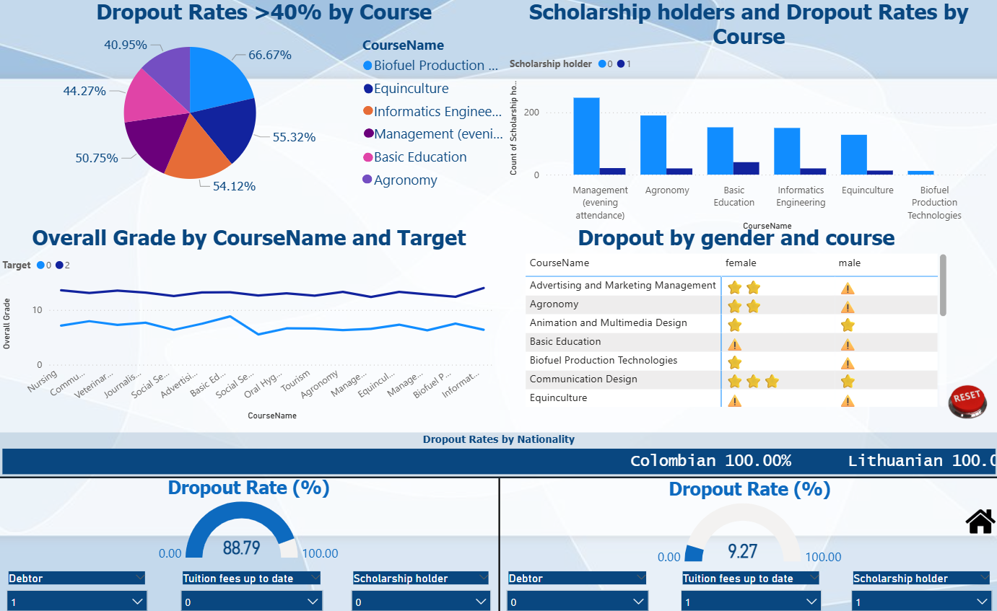
DATA PREPROCESSING

Slide 6

HOW TO IMPROVE THE MODEL
Use ML models inside every subgroup of the data (split by courses)
Include more variables like attendance
Collect more data for underrepresented programs

